Slide 1
Network Switching
Course Code: COE 3201
Course Title: Data Communication
Dept. of Computer Engineering
Faculty of Engineering
Lecture No: | 12 | Week No: | 13 | Semester:
Lecturer:

Slide 2
Lecture Outline
Switching Mechanism for Data Transfer
Circuit Switching
Message Switching
Packet Switching
Virtual Circuit Switching
Datagram Switching

Slide 3
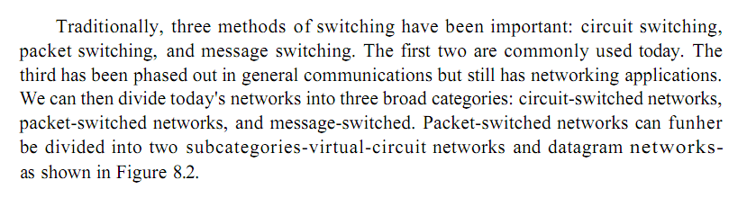
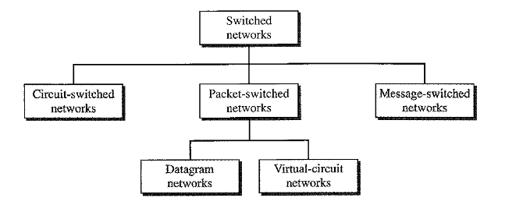
Switching Mechanism for Data Transfer
Taxonomy of Switched Network

Slide 4
Circuit Switching
Dedicated communication path between two stations
Must have switching capacity and channel capacity to establish connection
Must have intelligence to work out routing
Inefficient
Channel capacity dedicated for duration of connection
If no data, capacity wasted
Set up (connection) takes time
Developed for voice traffic (phone)
Examples
Telephone networks
ISDN (Integrated Services Digital Networks)

Slide 5
Circuit Switching
A
B
Node 1
Node 2
DATA
processing delay at Node 1
propagation delay
between A
and Node 1
Set-up phase
propagation delay
between B
and A
Data Transfer phase
Teardown phase

Slide 6
Message Switching
No dedicated path needs to be established between end-nodes.
Source and destination node do not interact in real time. There is no need to determine the status of the destination node before sending the message.
Each message is an independent entity and carries address information of the destination. There is no upper limit on the size of the message.
The messages are stored at each node before being forwarded to the next node in the route.
Message switching accept all traffic but offers longer delivery time than circuit switching. Circuit switching blocks/rejects access traffic.
Header
Data

Slide 7
Packet Switching
Messages are broken into small segments of bit-sequences and they are called packets. As packets are restricted to a specific size, they can be routed more rapidly.
Packets have the following structure:
Header carries control information (e.g., destination id, source id, message id, packet id, control info)
Each packet is passed through the network from node to node along some path (Routing)
At each node the entire packet is received, stored briefly, and then forwarded to the next node (Store-and-Forward Networks)
Typically no storage is required at nodes/switches for packets.
Header
Data

Slide 8
Packet Switching Advantages
Packetization allows short messages to get through a transmission link without waiting behind long messages.
Line efficiency
Single node to node link can be shared by many packets over time
Packets queued and transmitted as fast as possible
Packets are accepted even when network is busy
Delivery may slow down
Priorities can be used

Slide 9
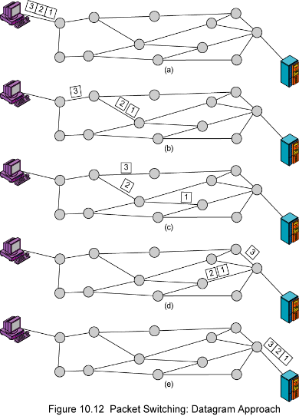
Datagram packet switching
Modify as appropriate…..
Each packet is independently switched
each packet header contains destination address
No resources are pre-allocated (reserved) in advance
Routes may change during session

Slide 10
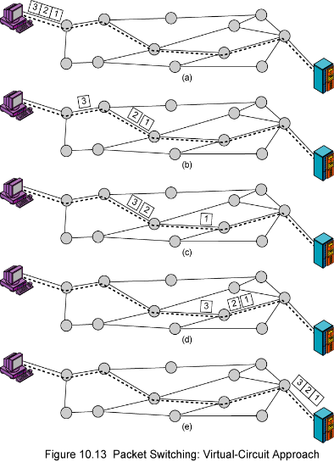
Virtual-Circuit Packet Switching
Preplanned route established before any packets sent
Call request and call accept packets establish connection (handshake)
Communication with virtual circuits takes place in three phases
VC establishment
data transfer
VC disconnect
Note: packet headers don’t need to contain the full destination address of the packet

Slide 11
Datagram vs. Virtual-Circuits Packet Switching
Datagram | Virtual circuits
No call setup phase Better if few packets More flexible Routing can be used to avoid congested parts of the network | Network can provide sequencing and error control Packets are forwarded more quickly No routing decisions to make Less reliable Loss of a node looses all circuits through that node

Slide 12
Books
1. Forouzan, B. A. "Data Communication and Networking. Tata McGraw." (2005).

Slide 13
References
1. Prakash C. Gupta, “Data communications”, Prentice Hall India Pvt.
2. William Stallings, "Data and Computer Communications”, Pearson
3. Forouzan, B. A. "Data Communication and Networking. Tata McGraw." (2005).

